Slide 1
LINEAR TRANSFORMATION
MATH 15 - Linear Algebra
Department of Mathematics

Slide 2
OBJECTIVES
At the end of this lesson, the students are expected to:
Define linear transformation.
Determine if a transformation is linear transformation.
Perform the transformation of given functions.

Slide 3
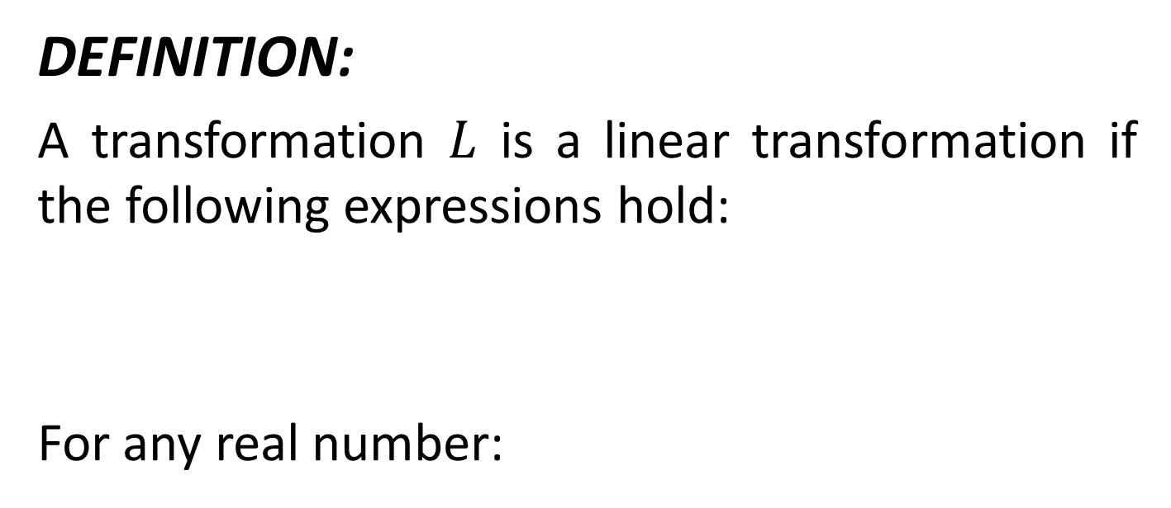
Linear Transformation
DEFINITION:
A transformation $L$ is a linear transformation if the following expressions hold:
For any real number:

Slide 4
LINEAR TRANSFORMATION
EXAMPLE:
Determine if the following transformations are linear transformation:
1. R² → R ³ :
2. R³ → P ₂ :
3. R³ → M_{22:}

Slide 5
LINEAR TRANSFORMATION
EXAMPLE:
Determine if the following transformations are linear transformation:
4. P₃ → P₂ :
5. R³ → R ² :
6. R² → R:

Slide 6
EVALUATION OF LINEAR TRANSFORMATION
The following operations are tested to be linear transformations. Evaluate the following linear transformations:
1. P₃ → P₂ :
Find D(5t³+2t²-3t+8)
2.R³ → R ²
Find:

Slide 7
EVALUATION OF LINEAR TRANSFORMATION
For the following items:
Given the transformation R² → R³ :
Find:

Slide 8
EVALUATION OF LINEAR TRANSFORMATION
For the following items:
Given the transformation R³ → R² :
Find:
Note:

Slide 9
ONE TO ONE LINEAR TRANSFORMATION
Recall that a function is 1-1 if f(x) = f(y)
implies that x = y
Since a linear transformation is defined as a function, the definition of 1-1 carries over to linear transformations. That is
Definition
A linear transformation L is 1-1 if for all vectors u and v, L(u) = L(v)
implies that u = v

Slide 10

KERNEL
DEFINITION:
The kernel of a linear transformation L is the set of all vectors v such that
L(v) = 0
Example: Find the kernel of

Slide 11
THEOREM
The kernel of a linear transformation from a vector space V to a vector space W is a subspace of V.

Slide 12
THEOREM
A linear transformation L is 1-1 if and only if Ker(L) = 0.

Slide 13
RANGE
Definition
Let L be a linear transformation from a vector space V to a vector space W. Then the range of L is the set of all vectors w in W such that there is a v in V with
L(v) = w
Theorem
The range of a linear transformation L from V to W is a subspace of W.

Slide 14

EXAMPLE
Let L be the linear transformation from R² → R³ be defined by
L(v) = Av
with
A. Find a basis for Ker(L).
B. Determine of L is 1-1.
C. Find a basis for the range of L.
D. Determine if L is onto.
Notes:
Solution
The Ker(L) is the same as the null space of the matrix A. We have
Hence a basis for Ker(L) is
{(3,-1)}
L is not 1-1 since the Ker(L) is not the zero subspace.
Now for the range. If we let {e_{i}} be the standard basis for R², then
{L(e₁), L(e₂)}
will span the range of L. These two vectors are just the columns of A. In general
The columns of A span the range of L.
A basis for the column space is L is given by the first column of A (the only corner of rref(A)). That is a basis is
{(1,2,3)}
Since the dimension of the range of A is 1 and the dimension of R³ is 3, L is not onto.
A Few Theorems
In the last example the dimension of R² is 2, which is the sum of the dimensions of Ker(L) and the range of L. This will be true in general.
Theorem
Let L be a linear transformation from V to W. Then
dim(Ker(L)) + dim(range(L)) = dim(V)
Proof
Let
S = {v₁, ..., v_{k}}
be a basis for Ker(L). Then extend this basis to a full basis for V.
T = {v₁, ..., v_{k}, v_{k+1}, ..., v_{n}}
We need to show that
U = {L(v_{k+1}k+1), ..., L(v_{n})}
is a basis for range L. If w is in the range of L then there is a v in V with L(v) = w. Since T spans V, we can write
v = c₁v₁ + ... + c_{k}v_{k} + c_{k+1}v_{k+1} + ... + c_{n}v_{n}
so that
w = L(v) = L(c₁v₁ + ... + c_{k}v_{k} + c_{k+1}v_{k+1} + ... + c_{n}v_{n})
= c₁L(v₁) + ... + c_{k}L(v_{k}) + c_{k+1}L(v_{k+1}) + ... + c_{n}L(v_{n})
= c₁0 + ... + c_{k}0 + c_{k+1}L(v_{k+1}) + ... + c_{n}L(v_{n})
= c_{k+1}L(v_{k+1}) + ... + c_{n}L(v_{n})
hence U spans the range of L. Now we need to show that U is a linearly independent set of vectors. If
c_{k+1}L(v_{k+1}) + ... + c_{n}L(v_{n}) = 0
then
0 = L(c_{k+1}v_{k+1} + ... + c_{n}v_{n})
hence
v = c_{k+1}v_{k+1} + ... + c_{n}v_{n}
is in Ker(L). But then v can be written as a linear combination of vectors in S. That is
c_{k+1}v_{k+1} + ... + c_{n}v_{n} = c₁v₁ + ... + c_{k}v_{k}
Which means that all of the constants are zero since these are linearly independent.
We call the dimension of Ker(L) the nullity of L and the dimension of the rang of L the rank of L.
We end this discussion with a corollary that follows immediately from the above theorem.
Theorem
Let L be a linear transformation from a vector space V to a vector space W with dim V = dim W, then the following are equivalent:
1. L is 1-1.
2. L is onto.

Slide 15
SUGGESTED READINGS
TEXTBOOKS
Elementary Linear Algebra, Bernard Kolman and David R. Hill, 7th ed., 2003
WEBSITES:
http://en.wikipedia.org/wiki/Eigenvalue,_eigenvector_and_eigenspace

